Slide 1

NAME- NAMAN CHAUHAN
ROLL NUMBER- 21030

Slide 2



1)

Slide 3
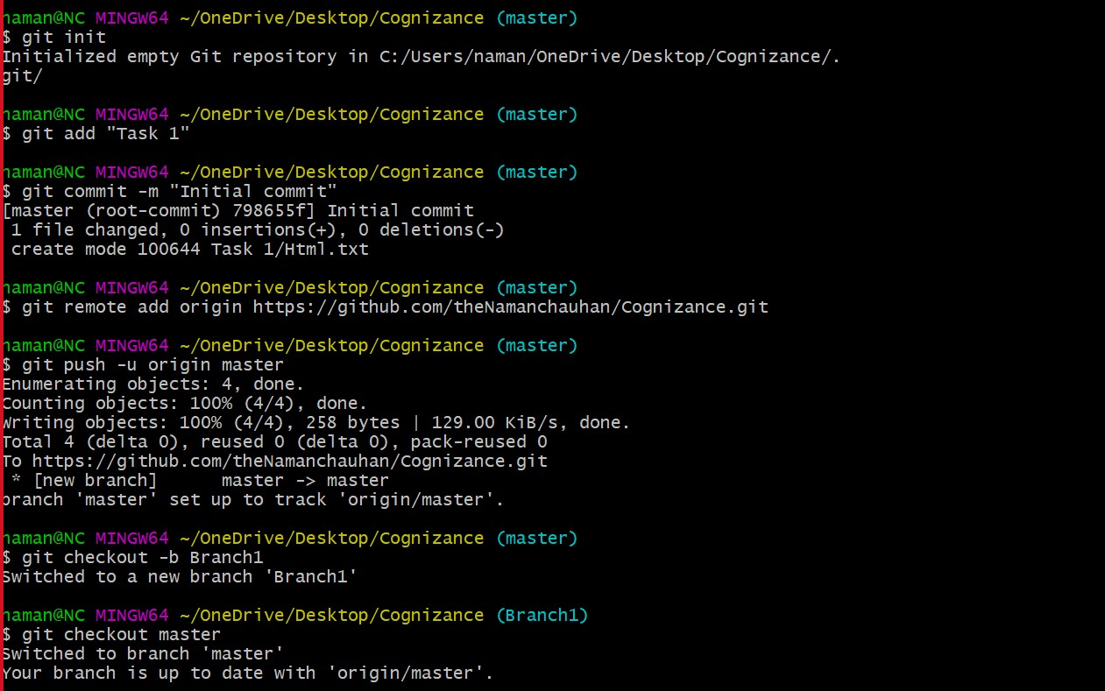
2)
add
commit
push

Slide 4
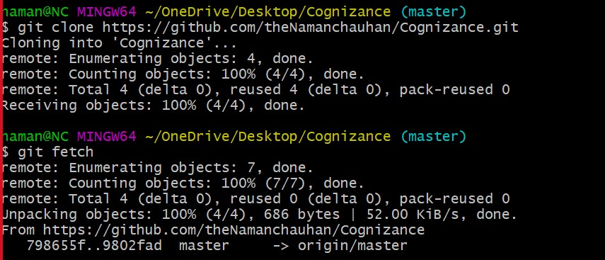
checkout -b
checkout
clone
fetch

Slide 5
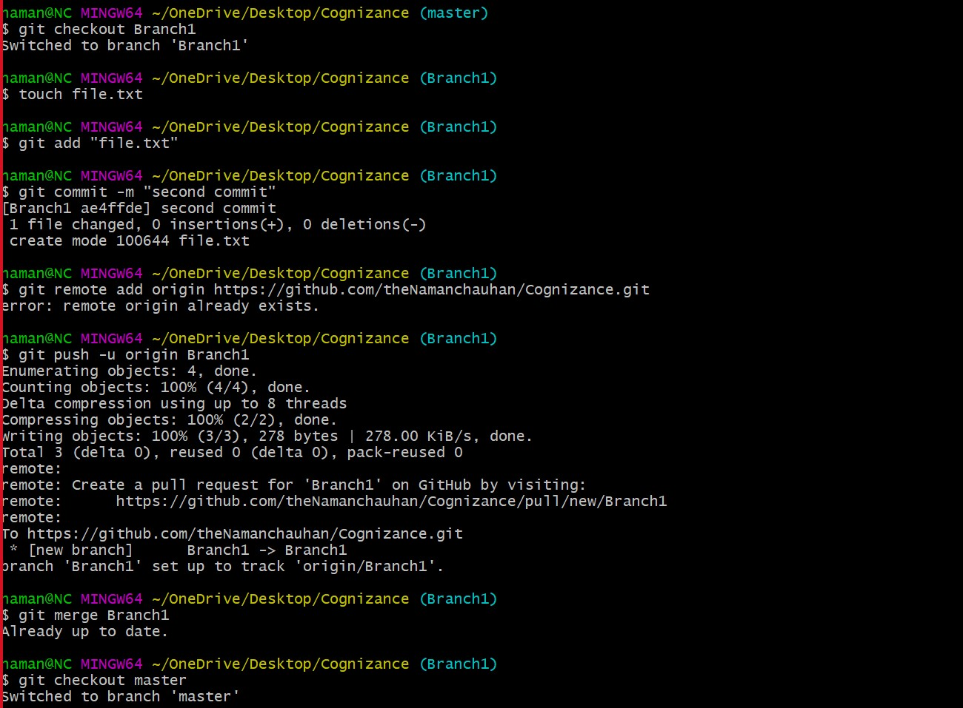

Slide 6
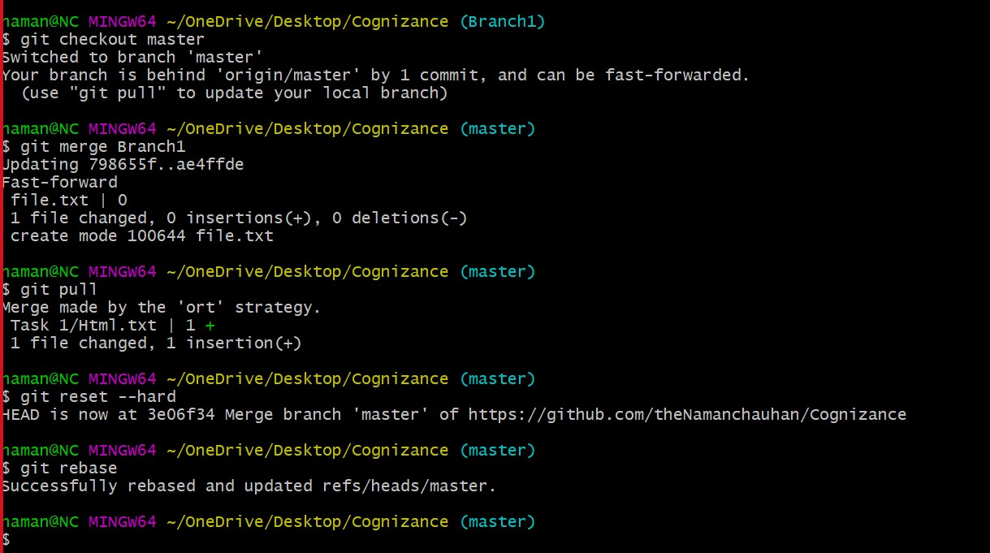
merge
pull
reset

Slide 7
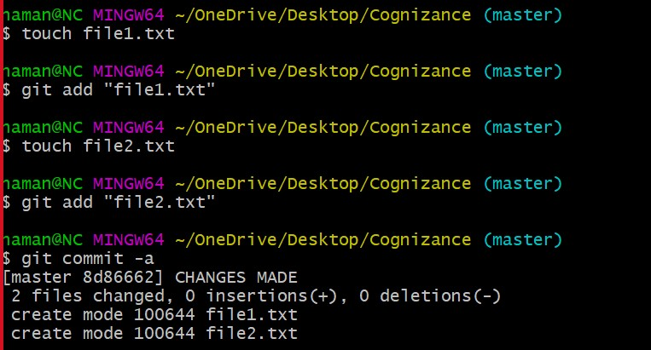
rebase
commit -a

Slide 8
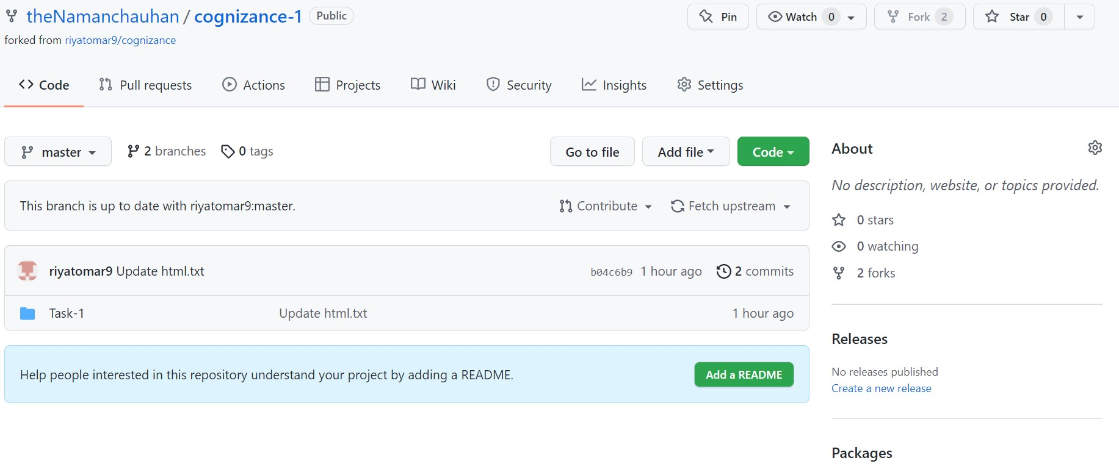
fork

Slide 9
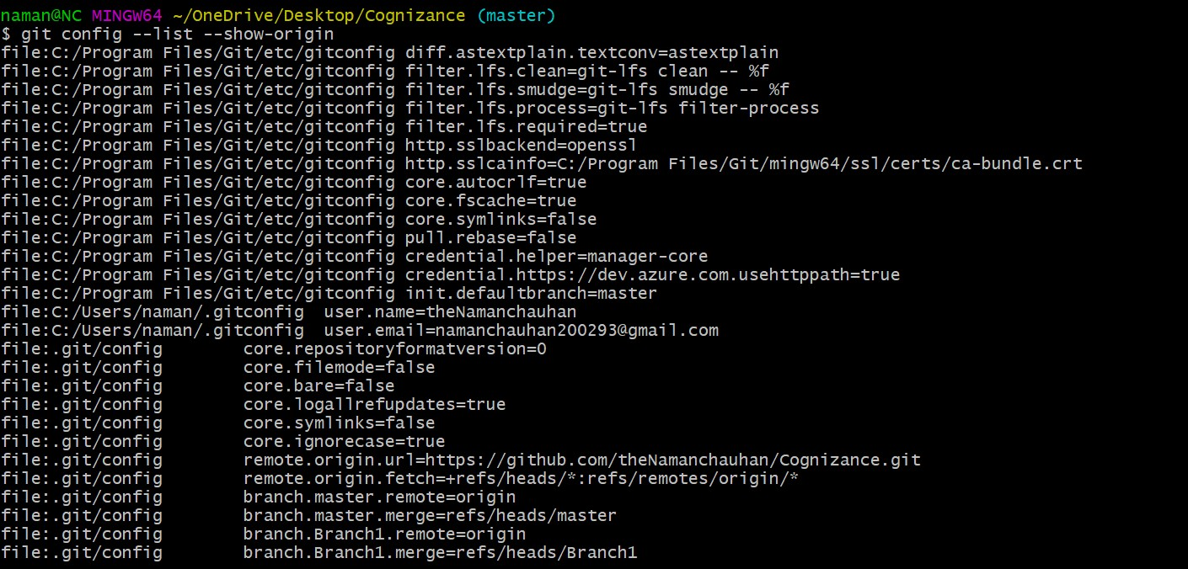
3)

Slide 10
